Slide 1
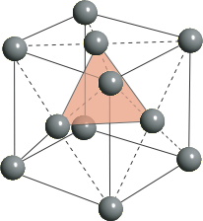
Close packed crystals
A plane
B plane
C plane
A plane
…ABCABCABC… packing
[Face Centered Cubic (FCC)]
…ABABAB… packing
[Hexagonal Close Packing (HCP)]
Notes:
0.74 for both fcc and hcp

Slide 2
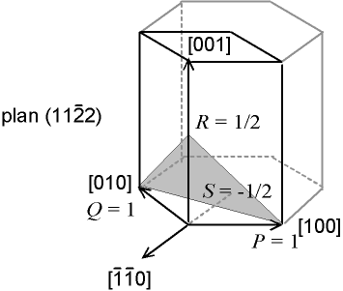
Hexagonal Has Different Notation
Hexagonal structure:
a-b plane (2D hexagon) can be defined by 3 vectors in plane (hkl)
3D structure can be defined by 4 miller indices (h k l m)
Third miller index not independent:
h + k = -l
m
e
k
h
l
Have more on HCP planes in the Additional Materials tab of website
Notes:
I don’t understand why the normal notation isn’t used either, but this is common to see.
Consider the (11-22) grey plane shown above. Notice the intercepts are at 1, 1, and ½ . Take reciprocals for h k and m. Then l is just found by the formula involving h and k above.

Slide 3
Indices of a Family
Sometimes several nonparallel planes may be equivalent by virtue of symmetry, in which case it is convenient to lump all these planes in the same Miller Indices, but with curly brackets.
Thus indices {h,k,l} represent all the planes equivalent to the
plane (hkl) through rotational symmetry.
Notes:
How many?
Try counting how many in: 001, 111, 012, 112, 123. Answers: 6, 8, 6*4=24, 6*4=24, 6*4*2=48 (I think, probably should check these numbers)

Slide 4
Indices of a Family
Sometimes several nonparallel planes may be equivalent by virtue of symmetry, in which case it is convenient to lump all these planes in the same Miller Indices, but with curly brackets.
Thus indices {h,k,l} represent all the planes equivalent to the
plane (hkl) through rotational symmetry.
Similarly, families of crystallographic directions are written as:
Notes:
Should always be used but people use the wrong notation quite frequently

Slide 5
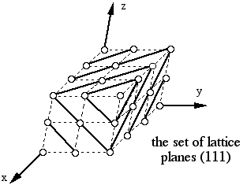
Why are planes in a lattice important?
(A) Determining crystal lattice parameters
* Diffraction methods measure the distance between parallel lattice planes of atoms to determine the lattice parameters (and other stuff)

Slide 6
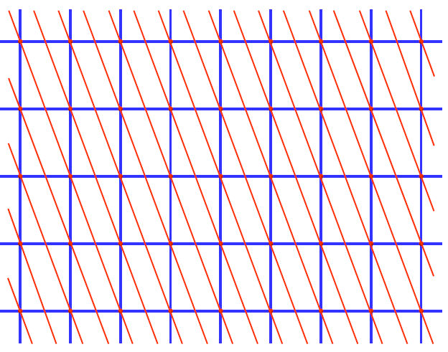
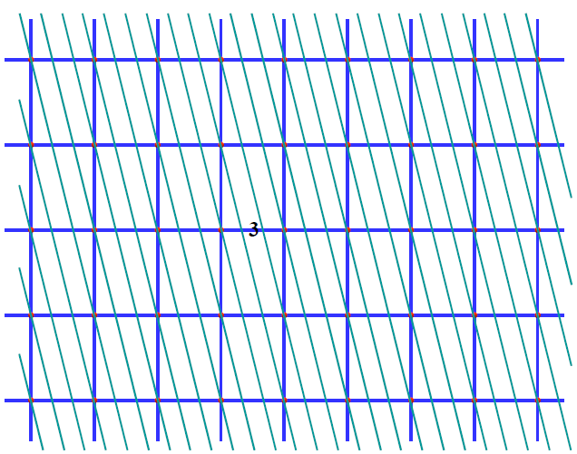
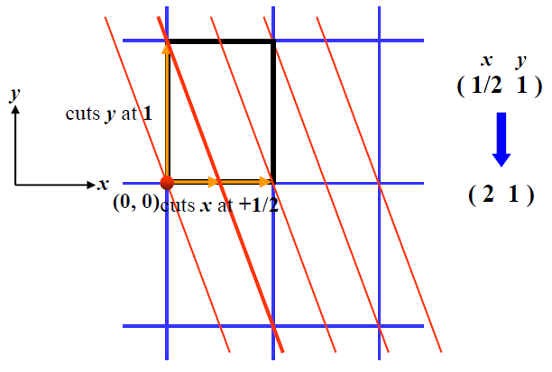
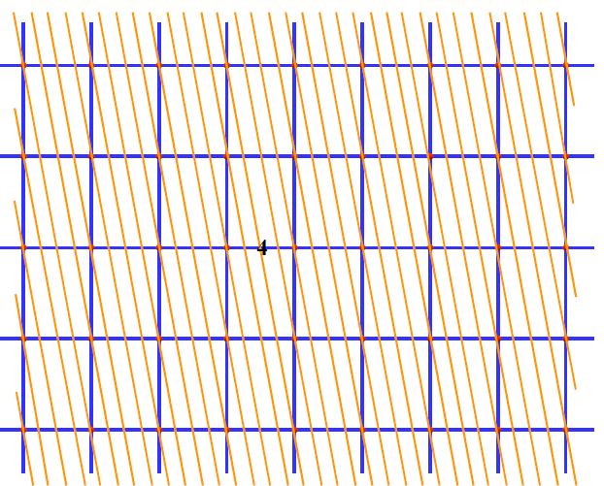
Identify these planes
y
x
How does the distance between the planes change?
Notes:
(2 1) (3 1) (4 1)
As the miller indices of the planes go up, the distance decreases

Slide 7
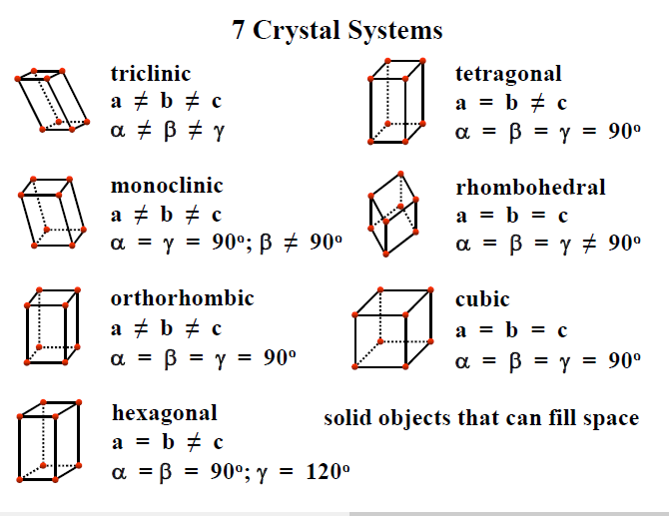
If you have orthorhombic tetragonal or cubic lattice, use this formula for distance between planes

Slide 8
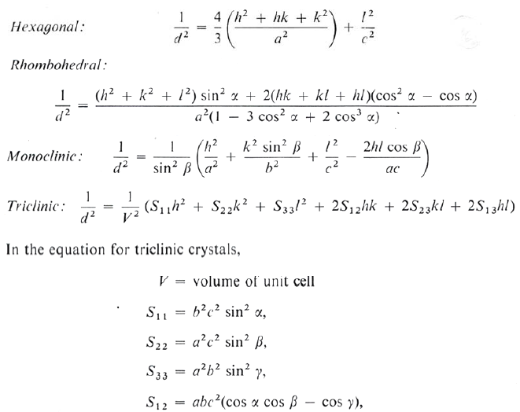
If you have orthorhombic tetragonal or cubic lattice, use this formula for distance between planes

Slide 9
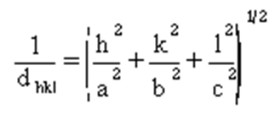
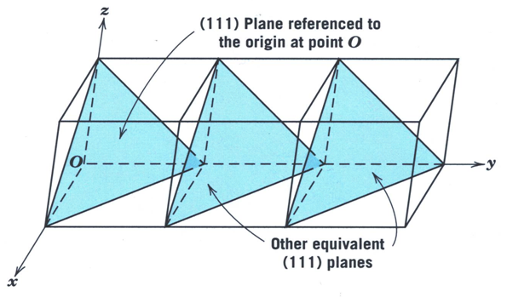
What is the distance between the (111) planes on a cubic lattice of lattice parameter a?
Notes:
(123) Plane distance = a/square root of 14) [worked out in notes, but easy]
Potentially discuss tetragonal lattice where a=b, but c different.

Slide 10
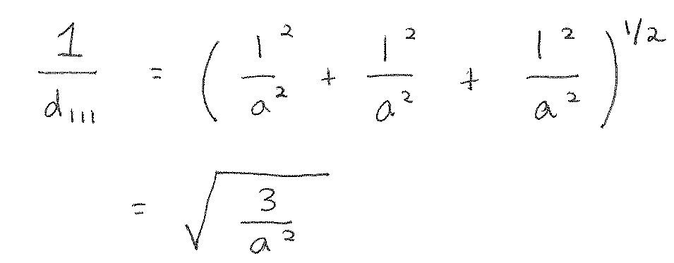
What is the distance between the (111) planes on a cubic lattice of lattice parameter a?
Notes:
(123) Plane distance = a/square root of 14) [worked out in notes, but easy]
Potentially discuss tetragonal lattice where a=b, but c different.

Slide 11
What is the distance between the (111) planes on a cubic lattice of lattice parameter a?
Find the distance between (1 2 3) in a cubic lattice?
Notes:
(123) Plane distance = a/square root of 14) [worked out in notes, but easy]
Potentially discuss tetragonal lattice where a=b, but c different.

Slide 12
What is the distance between the (111) planes on a cubic lattice of lattice parameter a?
Find d₁₁₁ in a tetragonal lattice where c = 2 a = 2b?
Notes:
(123) Plane distance = a/square root of 14) [worked out in notes, but easy]
Potentially discuss tetragonal lattice where a=b, but c different.

Slide 13
Non-closed packed structures
For more information: https://en.wikibooks.org/wiki/Introduction_to_Inorganic_Chemistry/Ionic_and_Covalent_Solids_-_Structures

Slide 14
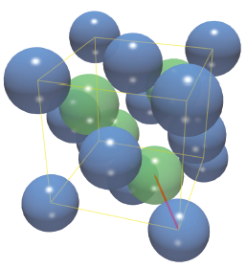
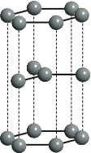
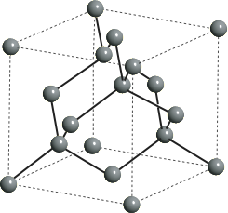
Other non close-packed structures
Packing isn’t the only consideration when building a lattice.
In covalently bonded materials, bond direction is more important than packing
graphite
diamond
How would you do packing factors in a system with more than one element?
Notes:
The APF for diamond (34%) is even less than for simple cubic (52%)!

Slide 15
Other non close-packed structures
Packing isn’t the only consideration when building a lattice.
In covalently bonded materials, bond direction is more important than packing
graphite
diamond
What is close packed direction?
How would you do packing factors in a system with more than one element?
Notes:
The APF for diamond (34%) is even less than for simple cubic (52%)!

Slide 16
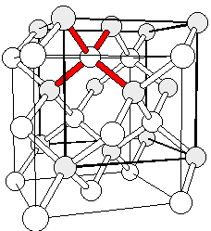
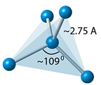
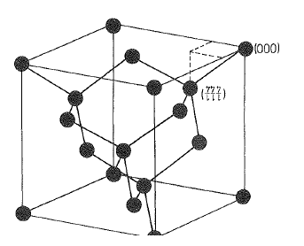
Simple Crystal Structures Diamond
Crystal class T_{d} (tetrahedral) - Each atom has 4 nearest-neighbors (nn). What elements might benefit from 4 neighbors?
Notes:
What is the close packed direction?

Slide 17
Simple Crystal Structures Diamond
Crystal class T_{d} (tetrahedral) - Each atom has 4 nearest-neighbors (nn). What elements might benefit from 4 neighbors?
What type of lattice?
Notes:
What is the close packed direction?

Slide 18
Simple Crystal Structures Diamond
Crystal class T_{d} (tetrahedral) - Each atom has 4 nearest-neighbors (nn). What elements might benefit from 4 neighbors?
What type of lattice?
Can be interpreted as two combined fcc structures
One atom at origin
Other atom displaced along diagonal (¼, ¼, ¼), Define all
Includes C, Si, Ge, α-Sn
Notes:
What is the close packed direction?

Slide 19
Defining the Crystal Structure
Lattice ≡ face centered cubic (fcc).
The fcc primitive lattice is generated by r = n₁a₁+n₂a₂+n₃a₃
with primitive lattice vectors:

Slide 20
Defining the Crystal Structure
Lattice ≡ face centered cubic (fcc).
The fcc primitive lattice is generated by r = n₁a₁+n₂a₂+n₃a₃
with lattice vectors:
a₁ = a(0,1,1)/2, a₂ = a(1,0,1)/2, a₃ = a(1,1,0)/2
Basis set: 2 atoms (specify element) at (000) and (¼ , ¼, ¼).
Diamond:
2 identical atoms in basis (e.g. 2 C)
fcc lattice

Slide 21
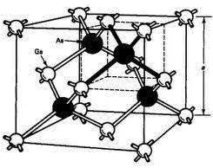
Defining the Crystal Structure
Lattice ≡ face centered cubic (fcc).
The fcc primitive lattice is generated by r = n₁a₁+n₂a₂+n₃a₃
with lattice vectors:
a₁ = a(0,1,1)/2, a₂ = a(1,0,1)/2, a₃ = a(1,1,0)/2
(NOTE: The a_{i}’s are not mutually orthogonal!)
Basis set: 2 atoms (specify element) at (000) and (¼ , ¼, ¼).
Diamond:
2 identical atoms in basis (e.g. 2 C)
fcc lattice
Zincblende:
2 different atoms in basis and fcc lattice
For FCC 2 atom ABCABC stacking, it is called zinc blende

Slide 22
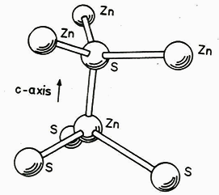
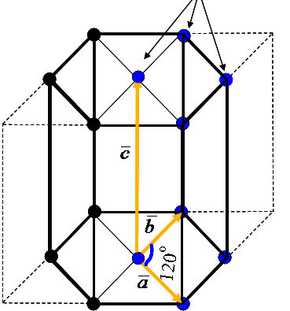
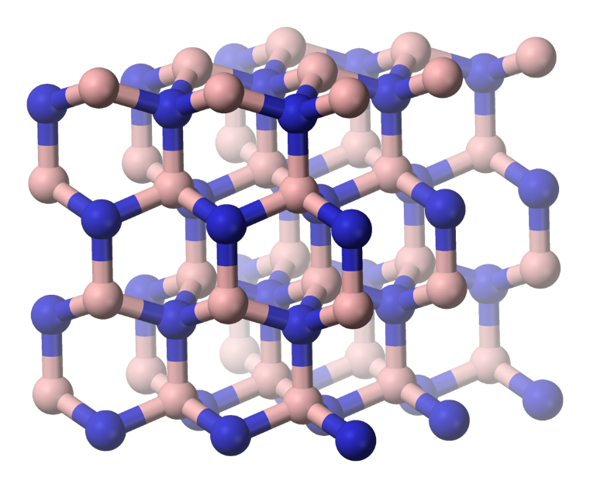
For ABAB… stacking it is called wurzite structure (fcc zincblende was ABCABC…)
Some compounds can have either structure (i.e., GaN, SiC)
Many semiconductors have the
Wurtzite Structure
Tetrahedral coordination: Each atom has 4 nearest-neighbors (nn). Basis set: 2 atoms. Lattice ≡ hexagonal close packed (hcp).
A Unit Cell looks like
hcp primitive lattice vectors :
a₁ = c(0,0,1)
a₂ = (½)a[(1,0,0) + (3)^{½}(0,1,0)]
a₃ = (½)a[(-1,0,0) + (3)^{½}(0,1,0)]

